Slide 1
Theory of Computation
CSE 3101
Lecture # 5
Md. Manowarul Islam
Lecturer, Dept of CSE
Jagannath University

Slide 2
Ending with a particular substring.
All strings ending with ‘n’ length substring will always require minimum (n+1) states
Determine the minimum number of states required in the DFA.
Draw those states
Decide the strings for which DFA will be constructed.
Construct a DFA for the strings
Always prefer to use the existing path.
Create a new path only when there exists no path to go with

Slide 3
Draw a DFA for the language accepting strings ending with ’01’ over input alphabets ∑ = {0, 1}
Regular expression for the given language = (0 + 1)*01
All strings of the language ends with substring “01”.
Minimum number of states required in the DFA = 2 + 1 = 3
0
1

Slide 4
Draw a DFA for the language accepting strings ending with ’01’ over input alphabets ∑ = {0, 1}
Consider some string
101, 001,0101,01101
1
0
0
1
0
1

Slide 5
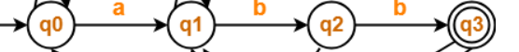
strings ending with ‘abb’ over input alphabets ∑ = {a, b}
Regular expression for the given language = (a + b)*abb
All strings of the language ends with substring “abb”.
Minimum number of states required in the DFA = 3 + 1 = 4

Slide 6
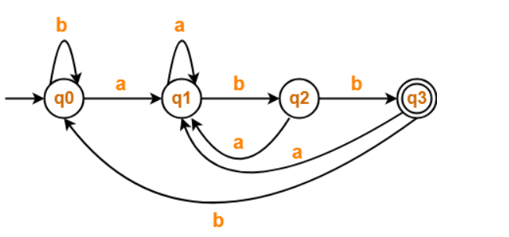
strings ending with ‘abb’ over input alphabets ∑ = {a, b}
Consider some string
babb, aaabb,abbabb

Slide 7
strings ending with ‘0011’ over input alphabets ∑ = {0, 1}
Regular expression for the given language = (0 + 1)*0011
All strings of the language ends with substring “0011”.
Minimum number of states required in the DFA = 4 + 1 = 5

Slide 8
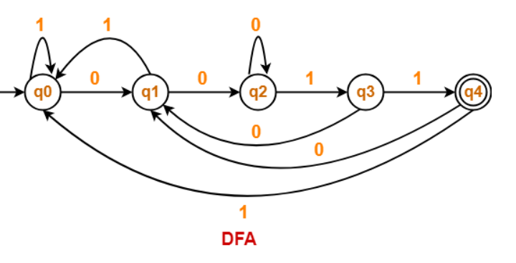
strings ending with ‘0011’ over input alphabets ∑ = {0, 1}
Regular expression for the given language = (0 + 1)*0011

Slide 9
starting with a particular substring.
All strings starting with ‘n’ length substring will always require minimum (n+2) states in the DFA.
One dead sate
Determine the minimum number of states required in the DFA.
Draw those states
Decide the strings for which DFA will be constructed.
Construct a DFA for the strings
Send all the left possible combinations to the dead state.

Slide 10
starting with ‘ab’ over input alphabets ∑ = {a, b}
Regular expression for the given language = ab(a + b)*
All strings of the language starts with substring “ab”.
Minimum number of states required in the DFA = 2 + 2 = 4

Slide 11
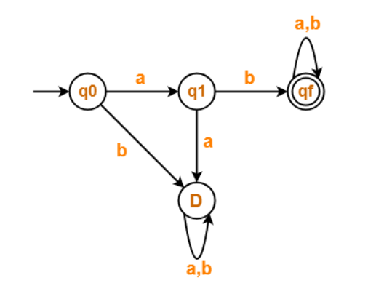
starting with ‘ab’ over input alphabets ∑ = {a, b}
Regular expression for the given language = ab(a + b)*

Slide 12
starting with ‘ab’ over input alphabets ∑ = {a, b}
Regular expression for the given language = ab(a + b)*

Slide 13
starting with ‘ab’ over input alphabets ∑ = {a, b}
Regular expression for the given language = ab(a + b)*

Slide 14
starting with ‘ab’ over input alphabets ∑ = {a, b}
Regular expression for the given language = ab(a + b)*

Slide 15
starting with ‘ab’ over input alphabets ∑ = {a, b}
Regular expression for the given language = ab(a + b)*

Slide 16
starting with ‘a’ over input alphabets ∑ = {a, b}
Regular expression for the given language = a(a + b)*
All strings of the language starts with substring “a”.
Minimum number of states required in the DFA = 1 + 2 = 3

Slide 17
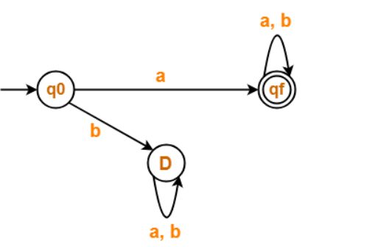
starting with ‘a’ over input alphabets ∑ = {a, b}
Regular expression for the given language = a(a + b)*

Slide 18
starting with ‘a’ over input alphabets ∑ = {a, b}
Regular expression for the given language = a(a + b)*

Slide 19
starting with ‘a’ over input alphabets ∑ = {a, b}
Regular expression for the given language = a(a + b)*

Slide 20
starting with ‘a’ over input alphabets ∑ = {a, b}
Regular expression for the given language = a(a + b)*

Slide 21
starting with ‘00’ over input alphabets ∑ = {0, 1}
Regular expression for the given language = 00(0 + 1)*
All strings of the language starts with substring “00”.
Minimum number of states required in the DFA = 2 + 2 = 4

Slide 22
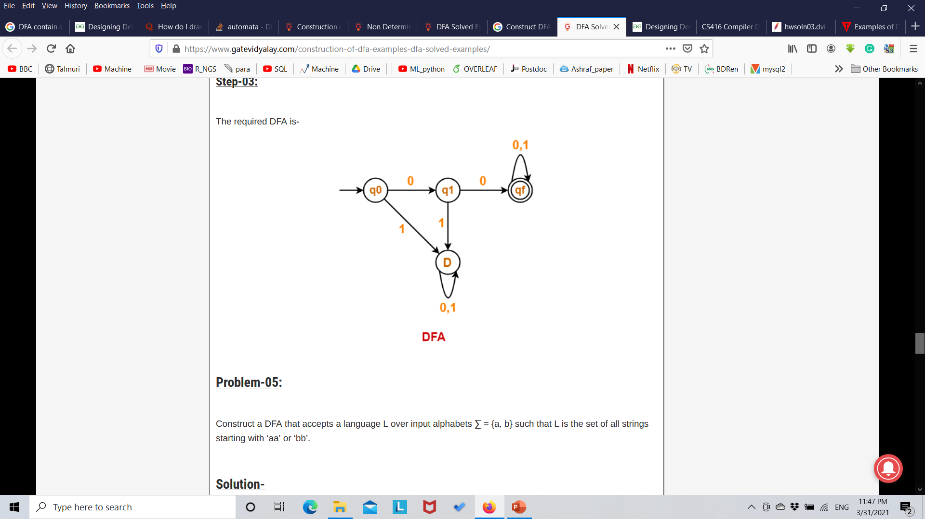
starting with ‘00’ over input alphabets ∑ = {0, 1}
Regular expression for the given language = 00(0 + 1)*

Slide 23
starting with ‘00’ over input alphabets ∑ = {0, 1}
Regular expression for the given language = 00(0 + 1)*

Slide 24
starting with ‘00’ over input alphabets ∑ = {0, 1}
Regular expression for the given language = 00(0 + 1)*

Slide 25
starting with ‘00’ over input alphabets ∑ = {0, 1}
Regular expression for the given language = 00(0 + 1)*

Slide 26
starting with ‘00’ over input alphabets ∑ = {0, 1}
Regular expression for the given language = 00(0 + 1)*

Slide 27
starting with ‘00’ over input alphabets ∑ = {0, 1}
Regular expression for the given language = 00(0 + 1)*

Slide 28
With a particular substring.
All strings starting with ‘n’ length substring will always require minimum (n+1) states in the DFA.
Determine the minimum number of states required in the DFA.
Draw those states
Decide the strings for which DFA will be constructed.
Construct a DFA for the strings

Slide 29
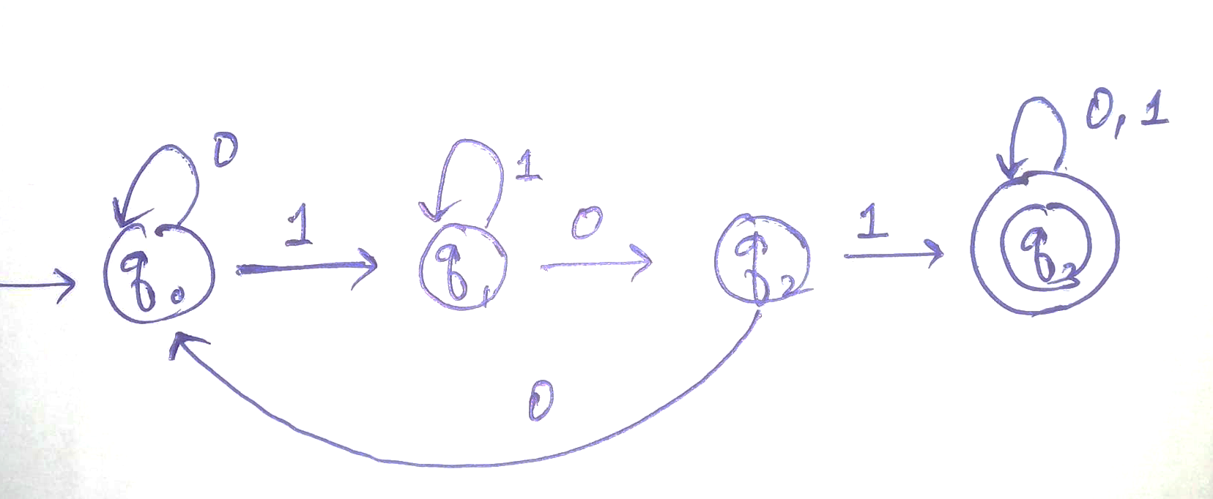
Strings which have ‘101’ as substring ∑ = {0, 1}
Regular expression for the given language = (0 + 1)*101(0 + 1)*

Slide 30
Strings which have ‘101’ as substring ∑ = {0, 1}
Regular expression for the given language = (0 + 1)*101(0 + 1)*

Slide 31
Strings which have ‘101’ as substring ∑ = {0, 1}
Regular expression for the given language = (0 + 1)*101(0 + 1)*

Slide 32
Strings which have ‘101’ as substring ∑ = {0, 1}
Regular expression for the given language = (0 + 1)*101(0 + 1)*

Slide 33
Strings which have ‘101’ as substring ∑ = {0, 1}
Regular expression for the given language = (0 + 1)*101(0 + 1)*

Slide 34
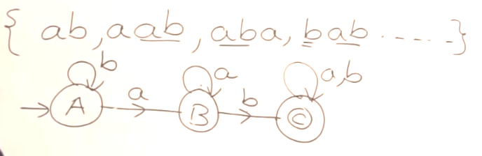
Strings which have ‘ab’ as substring ∑ = {a, b}
Regular expression for the given language = (a + b)*ab(a + b)*

Slide 35
Strings which have ‘ab’ as substring ∑ = {a, b}
Regular expression for the given language = (a + b)*ab(a + b)*

Slide 36
Strings which have ‘ab’ as substring ∑ = {a, b}
Regular expression for the given language = (a + b)*ab(a + b)*

Slide 37
Strings which have ‘ab’ as substring ∑ = {a, b}
Regular expression for the given language = (a + b)*ab(a + b)*

Slide 38
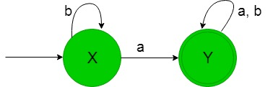
Strings which have ‘a’ as substring ∑ = {a, b}
Regular expression for the given language = (a + b)*a(a + b)*

Slide 39
Strings which have ‘a’ as substring ∑ = {a, b}
Regular expression for the given language = (a + b)*a(a + b)*

Slide 40
Strings which have ‘a’ as substring ∑ = {a, b}
Regular expression for the given language = (a + b)*a(a + b)*

Slide 41
Construct DFA to accept (0+1)*00(0+1)*
1
0
0
0
1
1

Slide 42
END

